Slide 1
HOUR-OF-CODE 2015
STEM Day
Sioux City, Iowa

Slide 2
What is Hour Of Code?

Slide 3
What will I learn?
You will be able to plan for an Hour – Of – Code event for your school or classroom next winter.
You will be able to write code that completes a task!

Slide 4
Why Programming?
Computational Thinking – Students today are facing problems and solutions that most people have never dreamt of before…
How are we preparing our 21st Century learners to CREATE in a world of technology?
Will our students be prepared to solve the problems of the future?
Notes:
Have you ever used Internet Explorer?
What do you use it for?
Have you ever thought about the programmer behind it? Who wrote the code for Internet Explorer?
Meet Hadi Partovi – Creator of code.org

Slide 6
Can Coding impact your Students?
What I love about teachers using technology.
Introducing students to new experiences that they wouldn’t get from a traditional classroom.
Allows a teacher to be spread thin, but still go deep into learning with students.
Gives kids a new way to differentiate and create while meeting the standards.

Slide 7
Decomposing
Step 1:
We are NOT talking about ZOMBIES here!
Breaking down BIG PROBLEMS into smaller LITTLE PROBLEMS.

Slide 8
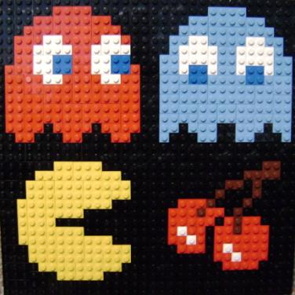
Patterns
Step 2:
Developing a sense of recognizing that these smaller pieces tend to have consistencies.
Likes and Differences

Slide 9
Abstraction
Step 3:
Ignoring the details that don’t fit the patterns.
Finding solutions that fit a general framework.
Multiple Problems solved!

Slide 10
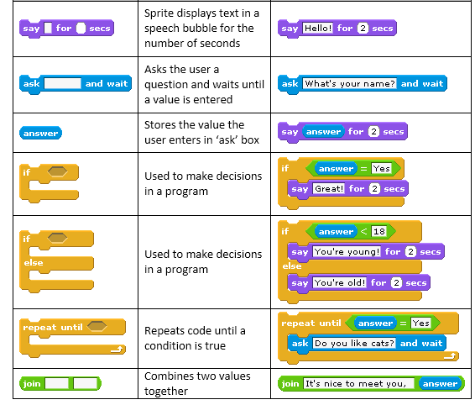
Algorithms
Step 4:
Writing instructions to complete the solutions.
Making step-by-step process to simplify and achieve.

Slide 12
Activities
Have an event for parents:
Cookies and Coding (Can you guess who our special guess was?)

Slide 13
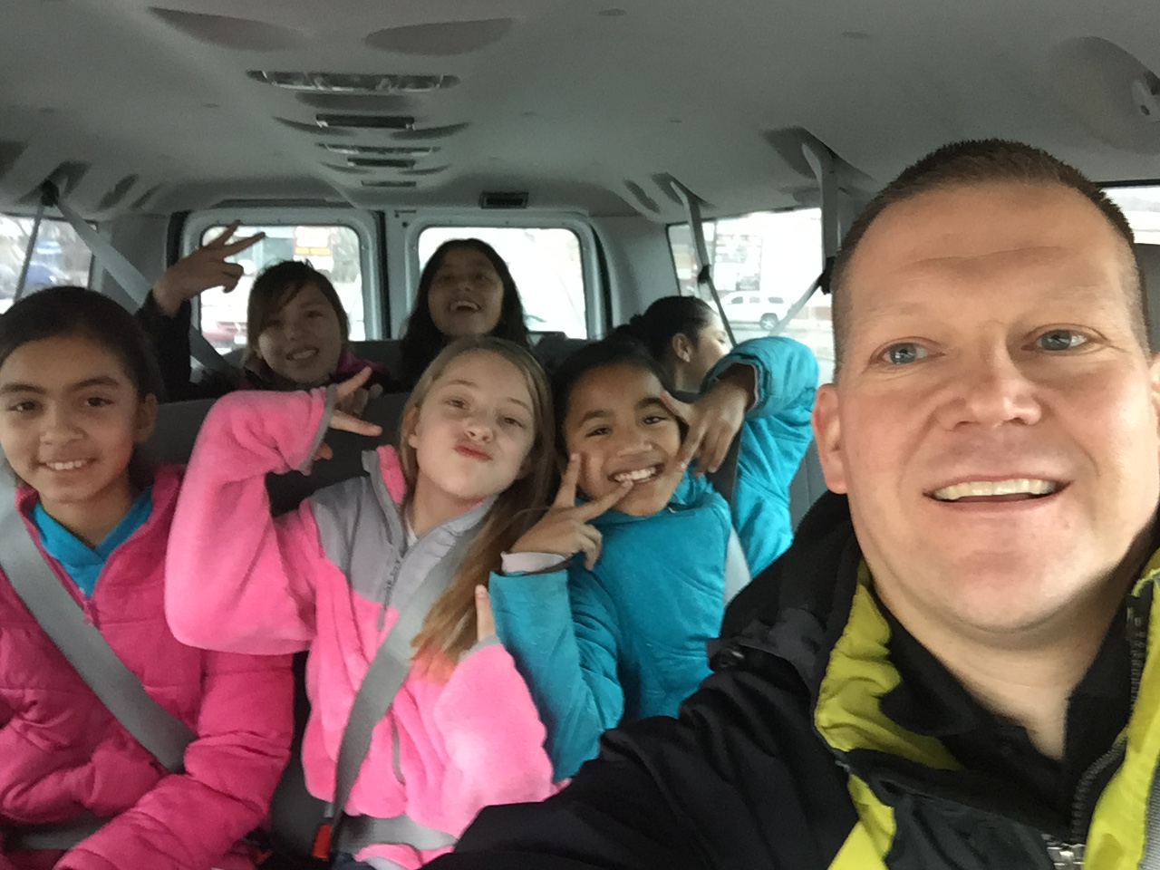
Activities
Visit another classroom and CODE TOGETHER!

Slide 14
Activities
Invite Parents to come to your classroom and have kids code with Mom or Dad.

Slide 15
Activities
Teach the principal or even the Supt. to code!

Slide 16
Activities
Have an Assembly!

Slide 17
WHAT’S the NEXT STEP?
Plan your Event…

Slide 18
WHAT’S the NEXT STEP?
Plan your Event…
tynker.com/hour-of-code/
http://code.org/learn
csedweek.org/learn
scratch.mit.edu/studios/283340/
hourofcode.com

Slide 19
Layne Henn Technology Consulting Teacher
Follow me on Twitter @sctechbuzz
Check out Instructional Tech on Facebook: https://www.facebook.com/SCCSDtech
find my website: http://laynehenn.weebly.com
hennl@live.siouxcityschools.com

